Slide 1
ISMRM 2013 Abstracts Work
Mathieu Boudreau
October 28th 2013
Biomedical Engineering Dept.
Committee:
Prof. Bruce Pike - Supervisor
Prof. Robert Funnell - Chair’s representative
Dr. Douglas Arnold - External member

Slide 2
Part 1: Rapid B1 Mapping – Are Novel Methods Better?

Slide 3

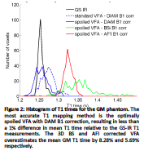
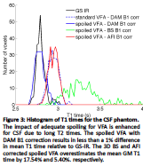
Overview of previous related work

Slide 4
Rapid B1 Mapping Techniques Comparison
Quantitative MT techniques have been moving from 2D to 3D recently
This requires faster B1 and T1 mapping methods to acquire whole-brain data in a reasonable acquisition time

Slide 5
Rapid B1 Mapping Techniques Comparison
Conventional Double Angle 4m38 s/slice
Bloch-Siegert (single slice) 18 s/slice
AFI (3D) 11 s/slice
EPI Double Angle (EPI Factor 9) 5 s/slice
(interleaved multi-slice)

Slide 6
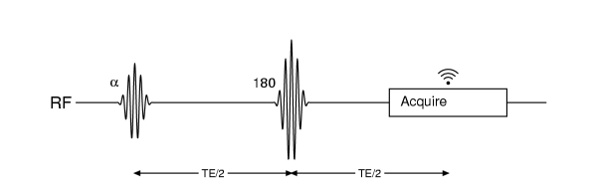
Basics of Double Angle B1 Mapping
Magnitude based method
Requires magnetization to be fully relaxed before each acquisition – very long TR
Timing diagram of the spin echo DA pulse sequence

Slide 7
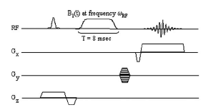
Basics of Bloch-Siegert B1 Mapping
Phase-based method
B1 calculated through a subtraction of the phase of two measurements
Timing diagram of the BS pulse sequence
Sacolick, L. , Magn. Res. Med. (2010)

Slide 8
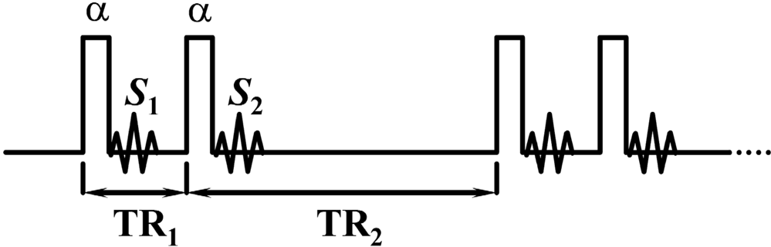
Basics of AFI B1 Mapping
Magnitude, steady-state based method
Assumes completely spoiled transverse magnetization at the end of both TRs
Timing diagram of the AFI pulse sequence
Yarnykh, V. , Magn. Res. Med. (2007)

Slide 9
Rapid B1 Mapping Techniques Comparison
Goal: Evaluate the VFA T1 maps produced using the 4 B1 mapping methods (DA, AFI, BS, EPI-DA)
The maps were WM mask using INSECT tissue classification on 1 x 1 x 1 mm³ T1w data
Then resampled to 2 x 2 x 5 mm³ using a majority voting method
6 subjects (4 currently processed)

Slide 10
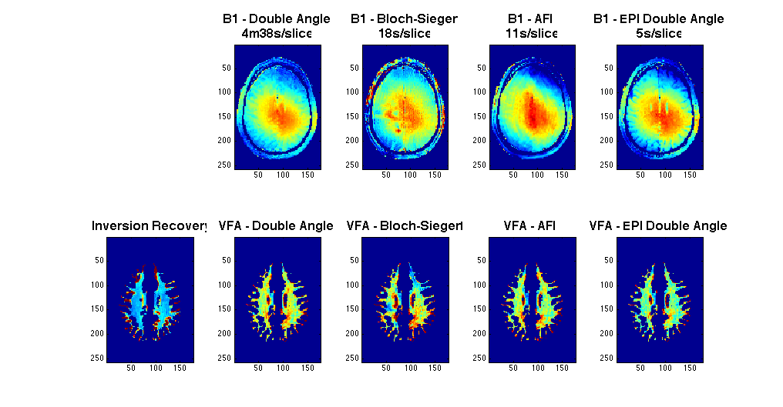
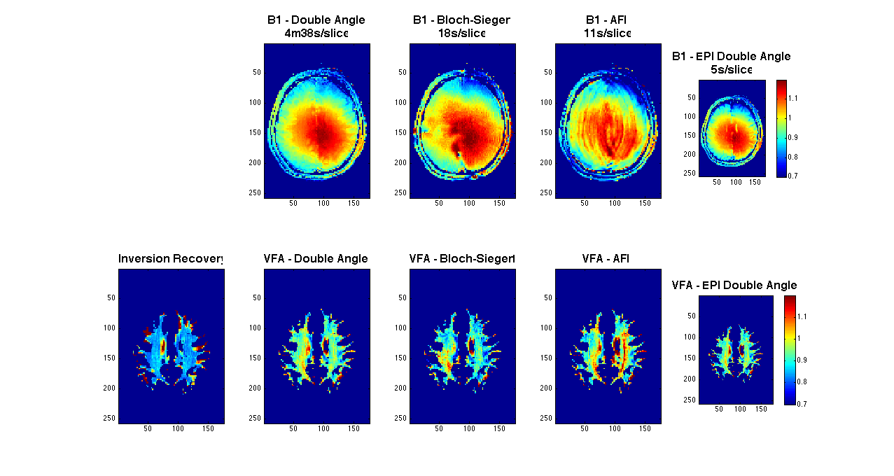
Subject 1 (2 x 2 x 5 mm³)

Slide 11
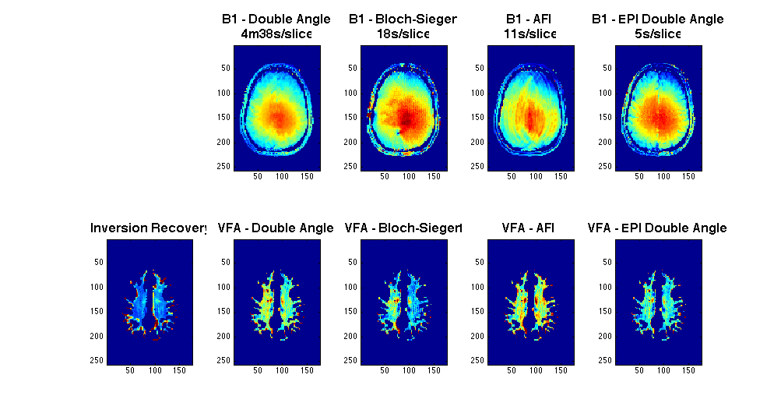
Subject 2 (2 x 2 x 5 mm³)

Slide 12
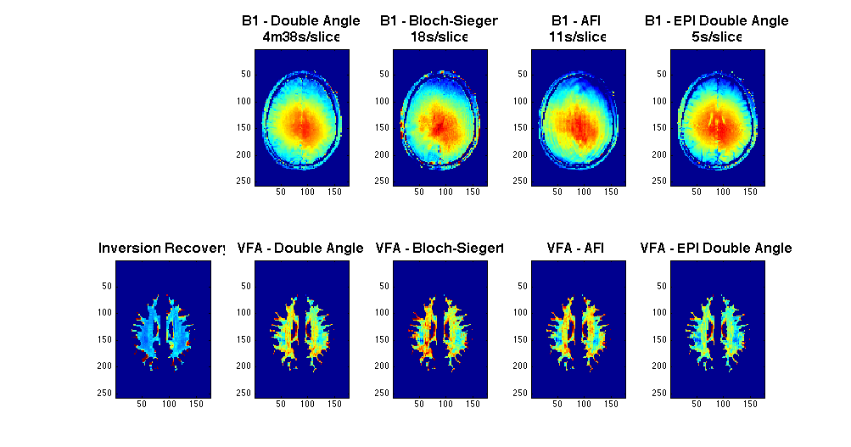
Subject 3 (2 x 2 x 5 mm³)

Slide 13
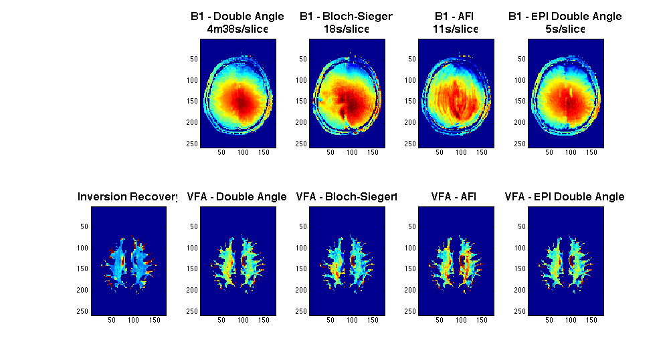
Subject 4 (2 x 2 x 5 mm³)

Slide 14
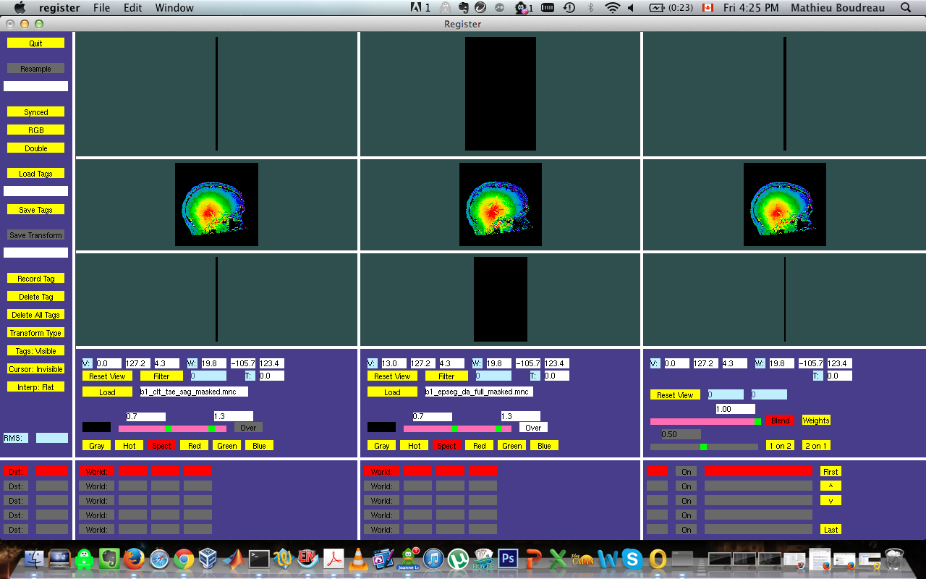
Sagittal Comparison (Subject 5) (2 x 2 x 5 mm³)
Conventional
Double Angle
EPI
Double Angle

Slide 15
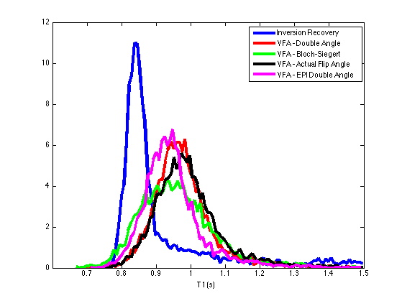
T1 Analysis (pooled 4 subjects)
B1 Method | T1 Method | T1 (ms)
n/a | IR | 915 ±151
DA | VFA | 978 ±89
BS |  | 961 ±110
AFI |  | 991 ±97
EPI-DA |  | 947 ±88

Slide 16
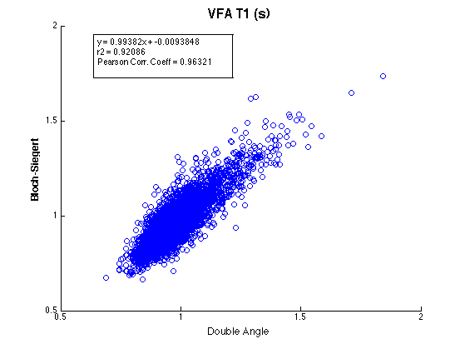
T1 Analysis (pooled 4 subjects)

Slide 17
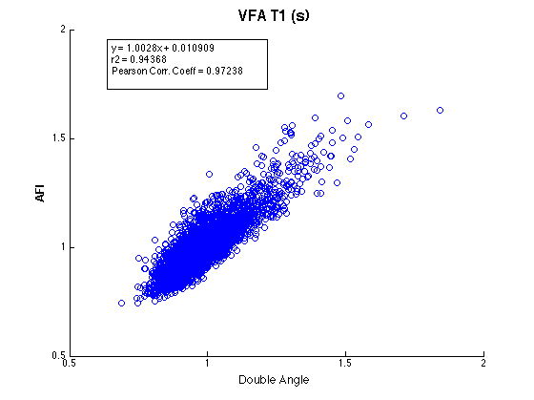
T1 Analysis (pooled 4 subjects)

Slide 18
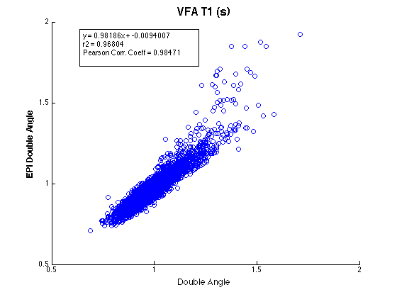
T1 Analysis (pooled 4 subjects)

Slide 19
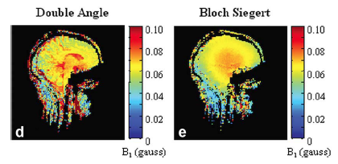
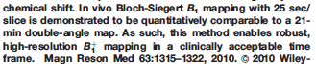
Discussion
Sacolick, L. , Magn. Res. Med. (2010)

Slide 20
Sagittal Comparison (Subject 5)
Conventional
Double Angle
EPI
Double Angle

Slide 21
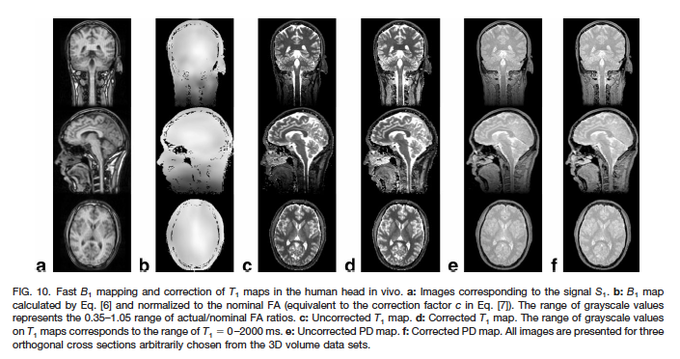
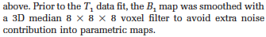
Discussion
Yarnykh, V. , Mag. Res. Med. (2007)

Slide 22
Discussion
Double Angle (and all methods) could be further accelerated through undersampling k-space (partial fourier, parallel imaging, compressed sensing, etc.)
B1 is expected to be a smoothly varying function in the brain, and good practice would be to smooth or interpolate B1 maps.
Are we gaining anything by using novel B1 methods?

Slide 23
Part 2: Evaluation of Different B1 and T1 Mapping Techniques on Quantitative Magnetization Transfer Imaging

Slide 24
Overview of previous related work

Slide 25
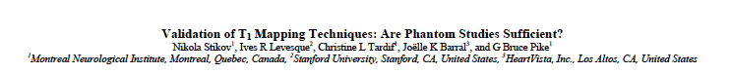
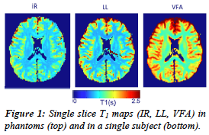
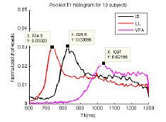
Overview of previous related work

Slide 26
B1/T1/qMT Comparison
qMT Requires B0, B1 and T1 maps for accurate parameter fitting.
To scan whole-brain qMT maps in a reasonable scan time, must change B1 and T1 techniques (old B1 – Double Angle, old T1 – Look-Locker)

Slide 27
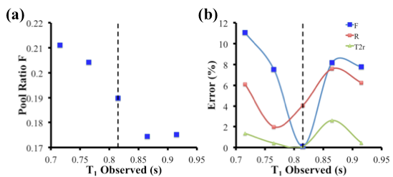
B1/T1/qMT Comparison
Last year – simulated effects of varying measured T1 on fixed qMT tissue parameters

Slide 28
B1/T1/qMT Comparison
Acquired 3 B1 maps (DA, AFI, Bloch-Sieg)
Acquired 3 T1 maps (IR, LL, VFA)
Acquired 2 qMT acquisition protocols (10p Optimized, 10p UK)
Fit qMT maps for all B1, T1, qMT protocol combinations
6 subjects (4 currently processed)

Slide 29
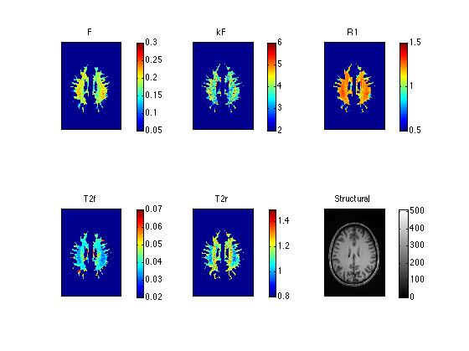
T1 = IR, B1 = DA, 10 Point Optimal qMT Single Subject (2 x 2 x 5 mm³)

Slide 30
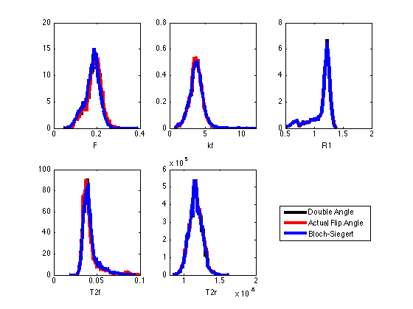
T1 = IR, 10 Point Optimal qMT B1 Comparison (pooled 4 subjects)

Slide 31
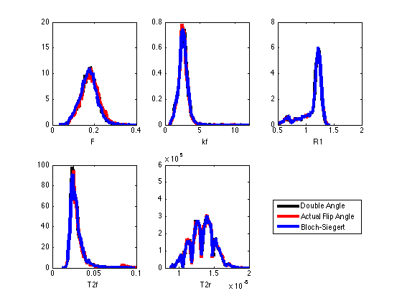
T1 = IR, 10 Point UK qMT B1 Comparison (pooled 4 subjects)

Slide 32
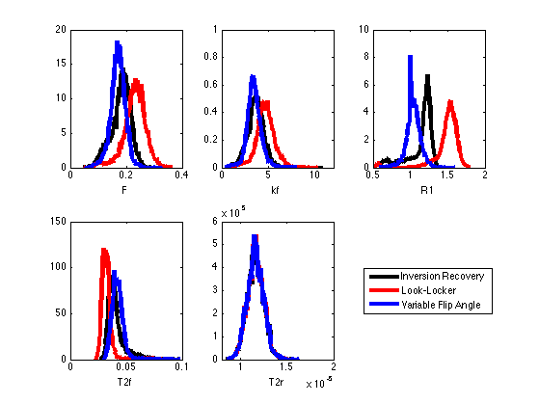
B1 = Double Angle, 10 Point Optimal qMT T1 Comparison (pooled 4 subjects)

Slide 33
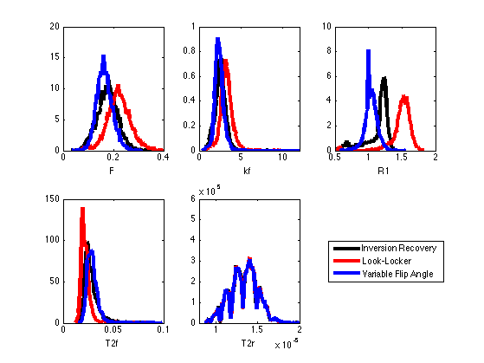
B1 = Double Angle, 10 Point UK qMT T1 Comparison (pooled 4 subjects)

Slide 34
Discussion
All tested B1 methods have no significant effects on fitted qMT parameters.
F, kf and T2f fitted with VFA (T1 overestimation relative to IR) deviate less from IR than LL.
But results in sharper histogram distributions than might physiologically occurs
Scaling VFA T1 to IR T1 may provide be a good compromise, but has yet to be tested

Slide 35
